Slide 1


GANGADHAR MEHER UNIVERSITY
Department of Information Science and Telecommunication
MAJOR PROJECT · INTERNSHIP
SkillStream
An online learning website,
built to be walked through in class.
Sneha Dhal
Frontend Developer
BSc in Information Science and Telecommunication
Internship at AediaX Tech Private Limited, Bhubaneswar · 2026

Slide 2
TODAY
What we will cover
01
02
The problem
The product
Why a clickable site, not only a design.
Catalogue, classroom, checkout, and admin.
03
04
How it is built
The live path
React, routes, and browser storage.
What to click, and what this preview does not do.
Sneha Dhal BSc IST AediaX Tech Private Limited
2 / 14

Slide 3
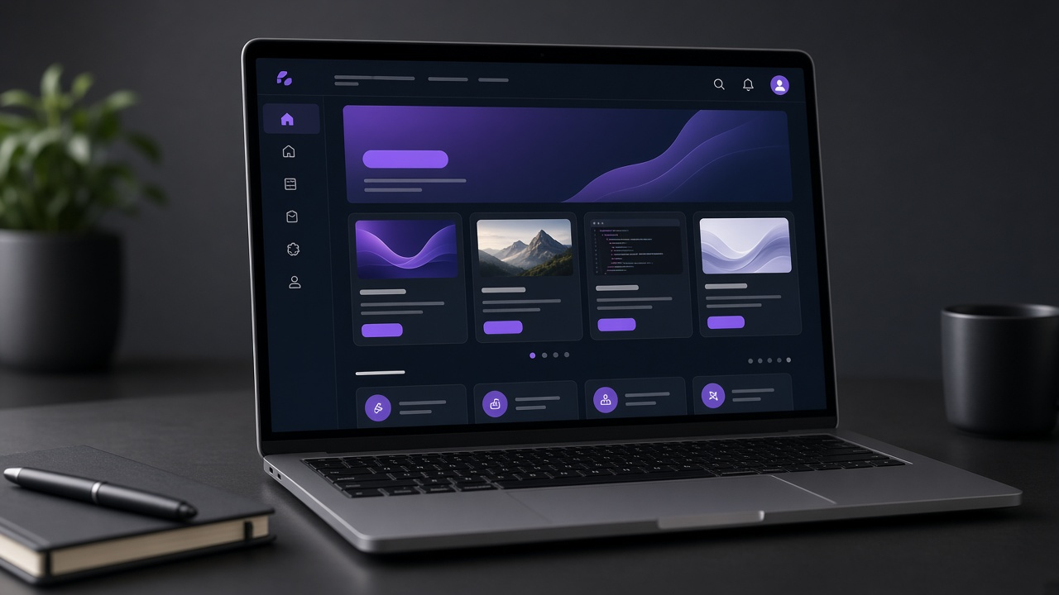
WHY
A design is not a website until you can use it
Marketplaces
Coursera-style sites cannot be restyled for a student project.
Video hosts
A playlist does not enrol you, save a lesson, or show a receipt.
A picture of a screen
It cannot filter courses, refuse a guest, or resume a lesson.
Sneha Dhal BSc IST AediaX Tech Private Limited
3 / 14

Slide 4
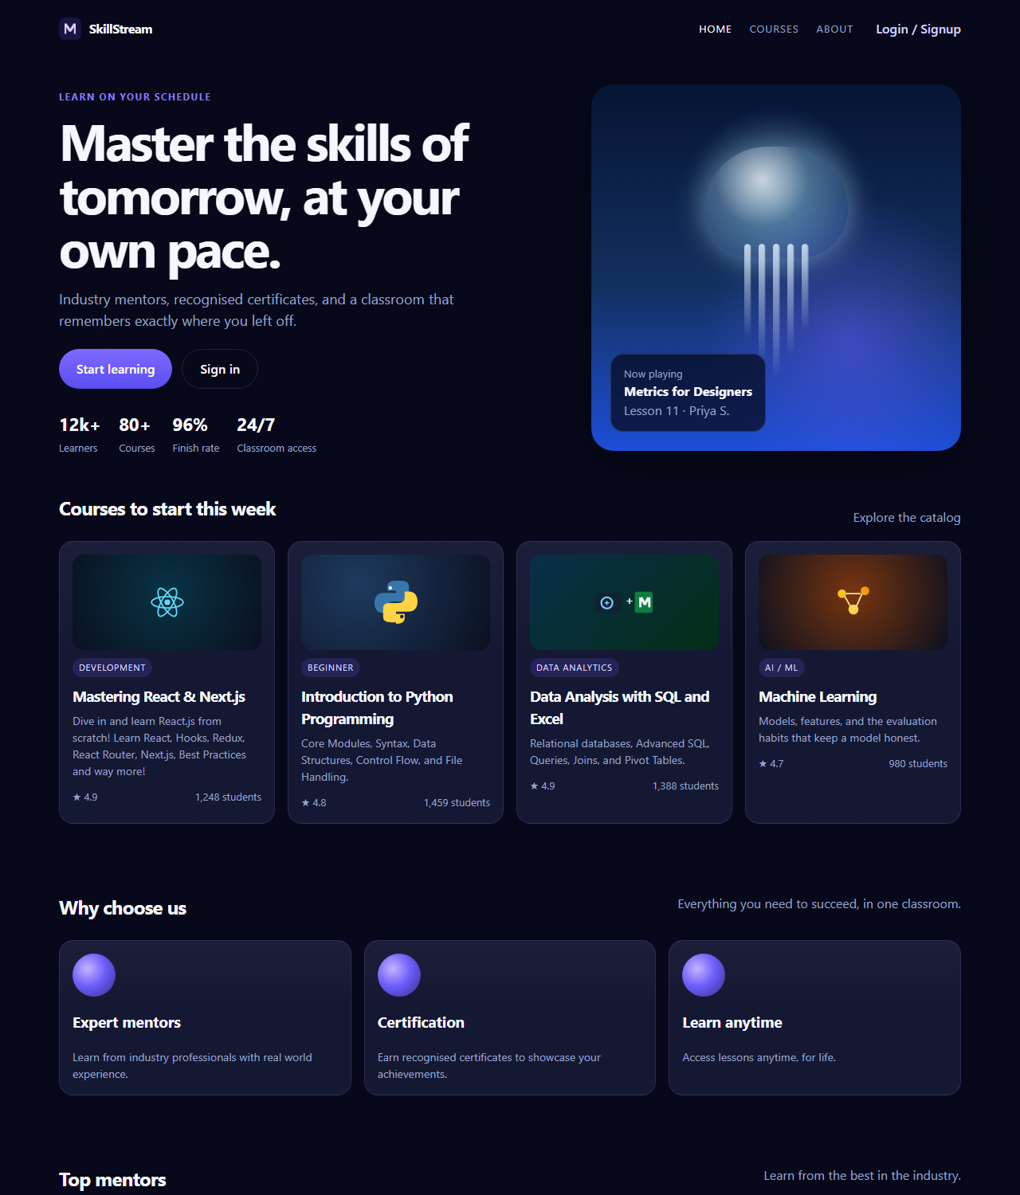
THE PRODUCT
SkillStream, in one sentence
A dark, desktop-first learning site: find a course, sign in, pass checkout, and continue in the classroom.
6
14
Courses
Screens
3
0
Checkout steps
Real charges
Sneha Dhal BSc IST AediaX Tech Private Limited
4 / 14

Slide 5
WHO
Two doors, one website
Learner
Administrator
• Browse and search the catalogue
• Sign in, or continue as the XYZ demo
• Checkout, then open My Courses
• Play a lesson and mark it done
• Edit profile and see receipts
• Separate sign-in at /admin/login
• Analytics from the stored session
• Add and delete notifications
• Save name, email, and site settings
• A different door from the learner
Sneha Dhal BSc IST AediaX Tech Private Limited
5 / 14

Slide 6
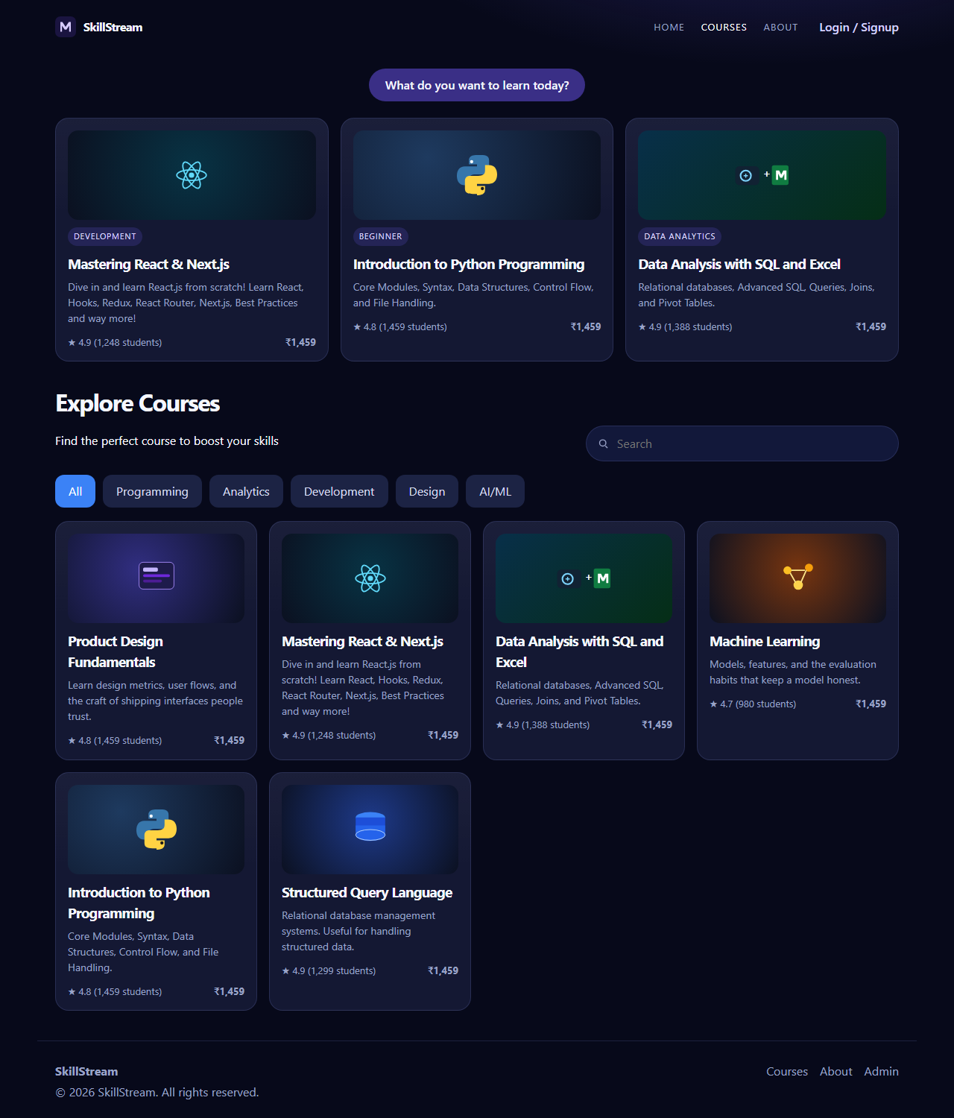
PUBLIC SITE
Landing, catalogue, and a course
Hero: Master the skills of tomorrow, at your own pace.
Search, plus category pills from All to AI/ML.
Six courses, ratings, and a list price of Rs 1,459.
A course page lists every lesson and an Enrol button.
A guest who chooses Enrol is sent to sign-in. Nothing is stored until they continue.
Sneha Dhal BSc IST AediaX Tech Private Limited
6 / 14

Slide 7
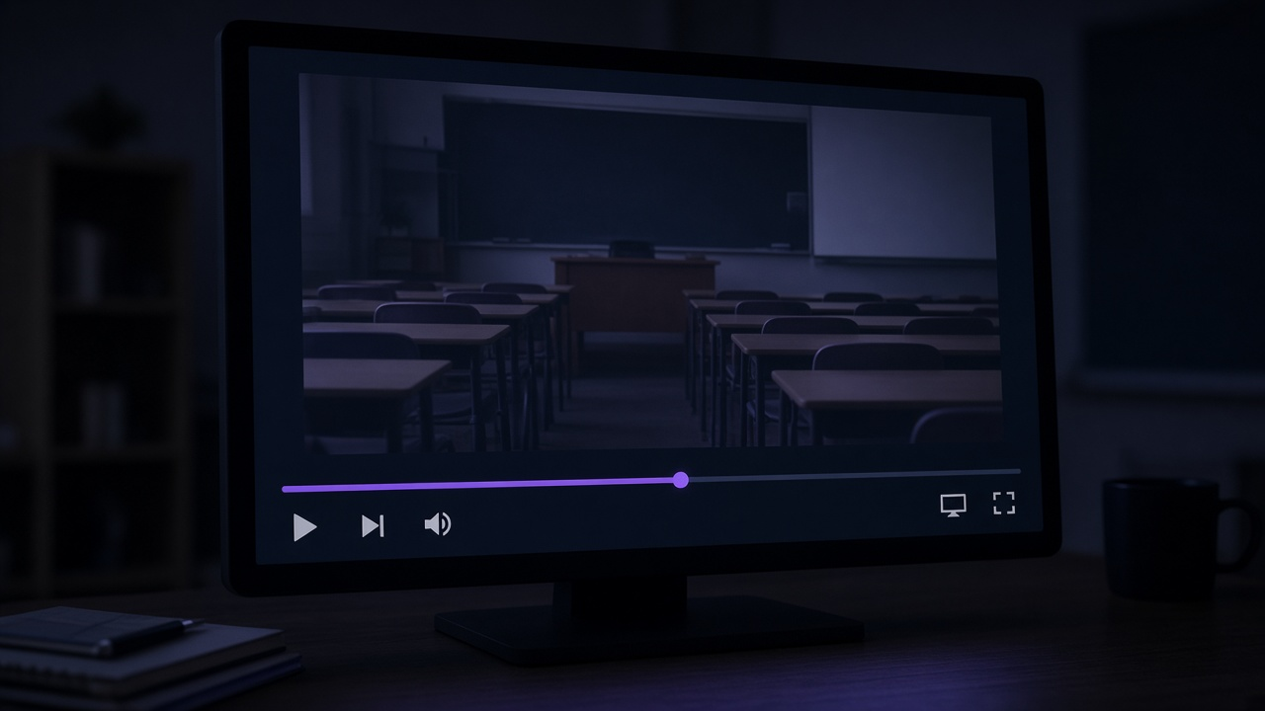
CLASSROOM
The lesson remembers where you stopped
Play and pause
A timer stands in for the lecture video.
Seek, skip, speed
1x, 1.25x, 1.5x, and 2x.
Captions
The lesson summary can sit on the player.
Mark as done
Updates progress and the daily-goal rings once.
Sneha Dhal BSc IST AediaX Tech Private Limited
7 / 14

Slide 8
CHECKOUT
Three steps. The React total matches the design.
1
2
3
Review
Details
Confirm
Order summary and what the course includes.
Name, email, and a demo card. Nothing is charged.
A local receipt, then the classroom opens.
React JS Complete Guide
Subtotal
Discount 20%
Tax 18%
Total
Rs 599
- Rs 120
Rs 86.22
Rs 754.82
Sneha Dhal BSc IST AediaX Tech Private Limited
8 / 14

Slide 9
AFTER SIGN-IN
Dashboard for the learner, tools for admin
Learner home
Administrator
• Greeting and a 16-day streak on the XYZ demo
• Daily goals: lessons 65%, watch time 40%, exercises 80%
• Four active courses, each with Continue watching
• Profile: edit details, Pro plan Rs 1,459 / month, delete account
• Analytics cards from the browser session
• Notifications: title, message, type, date
• Add a notice, or delete one
• Settings stay on this computer only
Sneha Dhal BSc IST AediaX Tech Private Limited
9 / 14

Slide 10
ARCHITECTURE
Three layers, all in the browser
Pages
Landing, catalogue, checkout, classroom, profile, admin
State
Sign-in, enrol, lesson position, mark done, notices
Storage
content.js for courses, and localStorage key skillstream-state-v1
Sneha Dhal BSc IST AediaX Tech Private Limited
10 / 14

Slide 11
STACK
Chosen because each one has a job
HTML
CSS
JavaScript
The page, the forms, and the player controls.
One dark system. No third-party UI kit.
Every interaction in this project.
React 18
React Router
Vite
Screens and shared shells as components.
An address for each screen, and guards for guests.
The local server and the production build.
Sneha Dhal BSc IST AediaX Tech Private Limited
11 / 14

Slide 12
IN CLASS
A two-minute path through the site
1
Open the landing page and choose Start learning.
2
On Courses, select Analytics. Only two courses stay in the grid.
3
Open the React course. Enrol sends a guest to sign-in.
4
Choose Continue as XYZ. The dashboard already has four courses.
5
Continue watching, then Mark as done. The goal rings move once.
6
Use the Admin link for analytics, notices, and settings.
Sneha Dhal BSc IST AediaX Tech Private Limited
12 / 14

Slide 13
HONEST LIMITS
What this preview is, and what is next
True of this build
Next, if the project grows
• Sign-in accepts a non-empty password.
• Checkout writes a receipt. No bank is called.
• The player is a timer, not a hosted video.
• Progress lives in this browser only.
• A real identity service.
• A payment provider, with no card stored here.
• Hosted lesson video on the same controls.
• One account across two browsers.
Sneha Dhal BSc IST AediaX Tech Private Limited
13 / 14

Slide 14
THANK YOU
Questions
Sneha Dhal
BSc in Information Science and Telecommunication
Gangadhar Meher University, Sambalpur
Internship at AediaX Tech Private Limited, Bhubaneswar
Frontend Developer · SkillStream · 2026

